Slide 1
Depreciation calculator Project
Subtitle :An Analytical Approach to Asset Value Reduction
Presented By :- {Vishal Nadiwal}
Date : 26 June 2025

Slide 2
Introduction
In this introduction Topic what we have learn Today , So this is the list of the topic we covered Today.
1} What is Depreciation?
2] Why it is important ?
3} Project Objectives ?
Depreciation refers to the gradual reduction in the value of an asset over time due to wear and tear, usage, or obsolescence. It is important for help track the true value of asset and necessary for accurate financial reporting & crucial for tax budgeting purposes
PROJECT OBJECTIVES
To develop an easy – to- use Depreciation calculator that computer asset depreciation using standard accounting methods, enabling informed decision-making and compliance

Slide 3
METHODOLOGIES USED IN DEPRECIATION
There are several commonly used depreciation methods in accounting to allocate the cost of an asset over its useful life
There are two types of method
Straight Line Method (ii) Diminishing Balance Method iii) Double diminishing Method
Straight line method :-The straight-line method depreciates an asset by the same fixed amount each accounting period until the asset’s value reaches its salvage (residual) value
Calculation of Straight line method
For example
Company A purchase a machine for $100,000 with an estimated salvage value of $ 20,000 and a useful life of 5 years.
Formula depreciation per year = (Asset Price - Scrap Value) / Estimated Life Span. ($100,000 -$20,000) 5
= $80000/5
=$16000

Slide 4
Straight Line Chart Graphs

Slide 5
Diminishing Balance Method
The Diminishing Balance Method depreciates an asset by a fixed percentage of its book value each year. This means higher depreciation in the early years and lower in the later years (Also called Declining Balance Method)
How the Diminishing Balance Method Works
The formula for calculating depreciation using the Diminishing Balance Method is as follows:
Depreciation Expense = (Opening Book Value * Depreciation Rate)
For example
Consider an Indian transportation company that purchases a vehicle for ₹5,00,000 with a diminishing balance depreciation rate of 30%. The calculation proceeds as follows:
Year 1: 5,00,000 * 30% = ₹1,50,000
Book Value at the end of Year 1: ₹5,00,000 – ₹1,50,000 = 3,50,000
Year 2: 3,50,000 * 30% = ₹1,05,000
Book Value at the end of Year 2: ₹3,50,000 – ₹1,05,000 = 2,45,000
Year 3: 2,45,000 * 30% =73500
Book Value At the end of the year 3: 2,45000-73500= 171500

Slide 6
Diminishing Balance Method Chart Graph

Slide 7
Advantages and Disadvantages of Straight line methods
Advantages
Simplicity: Easy to understand and apply.
Consistency: Equal depreciation each year simplifies budgeting and financial analysis.
Fair for uniform usage: Suitable if the asset's utility is consistent over time.
Comparability: Easier to compare expenses across years.
Disadvantages
Ignores higher early wear and tear: Not ideal for assets that lose more value in earlier years.
May not reflect actual usage: Assumes constant value loss regardless of real wear or usage.
Doesn’t match revenues well: May not align with income generated by the asset over time.

Slide 8
Advantages and Disadvantages of Diminishing balance Methods
Advantages:
Reflects asset usage: Higher depreciation in early years aligns with higher productivity or wear.
Better matching of expenses with income: Useful for revenue-generating assets.
Tax benefits: Higher early-year depreciation can reduce taxable income.
Disadvantages:
Complexity: Calculations can be more complicated.
Uneven expense recognition: Can distort financial results year to year.
Never fully depreciates: Asset value never technically reaches zero.
Less suitable for assets with uniform utility: Like buildings or office furniture

Slide 9
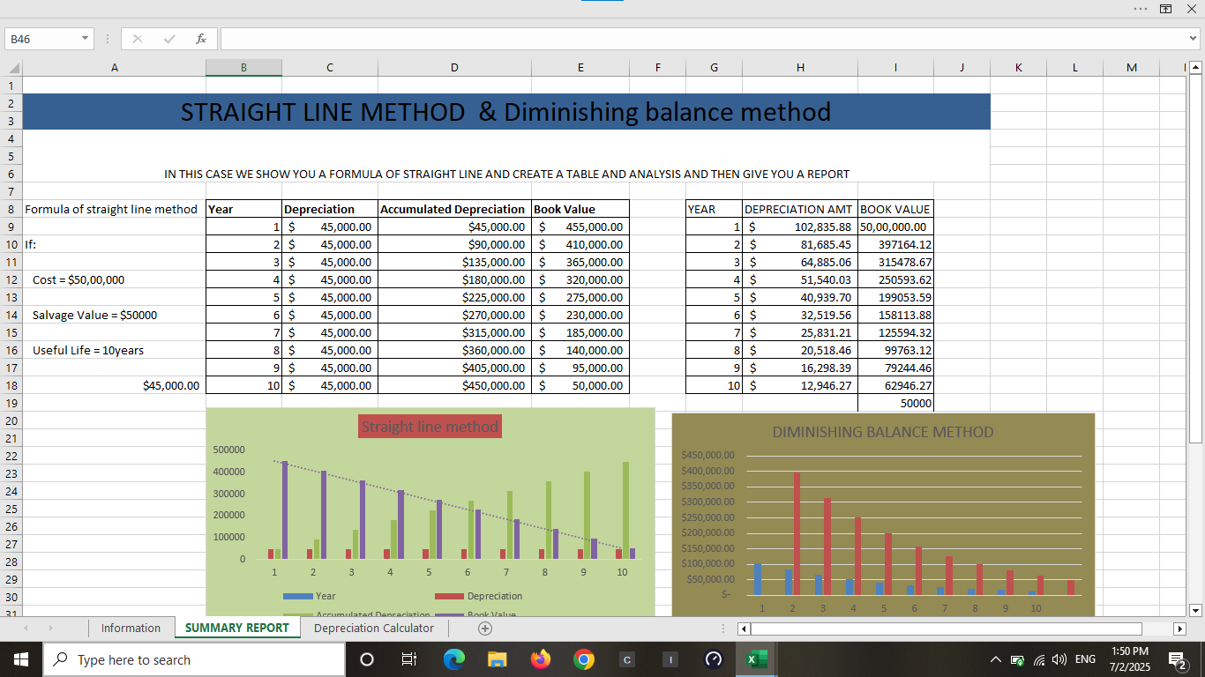

Slide 10
SOME BASIC QUESTION OF STRAIGHT LINE
1 Calculate the Asset Price ?
Asset Price=Cost=Depreciation +Salvage Value
2.What is the depreciation as per straight line method ?
Annual Depreciation=Useful Life (Years)Cost−Salvage Value
3. What is the depreciation percentage for the straight-line method?
Depreciation %=(Useful Life (Years)1​)×100
What is the total depreciation for its life span?
Total Depreciation=Asset Cost−Salvage Value
5 Find the depreciated book value after its life span?
. Book Value (End of Life)=Asset Cost−Total Depreciation OR simply:

Slide 11
Some basics question of diminishing balance methods
1 Calculate the Asset Price?
Asset Price=Rate/100Year 1 Depreciation​
2 . Find the rate of depreciation as per diminishing balance method
R=(1−(CostFinal Book Value​)n1​)×100
Where:
RRR = Depreciation Rate
nnn = Useful Life (Years)
Cost = Initial Asset Price
Final Book Value = After n years

Slide 12
DEPRICATION CALCULATOR PROJECT
SOME IMPORTANT KEY SHOWING UP NEXT
CALCULATE ASSEST VALUE IN STRAIGHT LINE ??
CALCULATE THE SLN,SYD,DB, DD, UNIT OF PRODUCTION??
CREATE A PIVOT TABLE ANALYSIS &VISUALIZATION??
NEXT SOME IMPORTANT KEY DASHBOARD AND SLICER CREATE IN THE NEXT UP COMING SLIDE
SOME KEY KPI WILL BE METION ??
SOME INSIGHT/CONCLUSION IS ALSO THERE ??

Slide 13
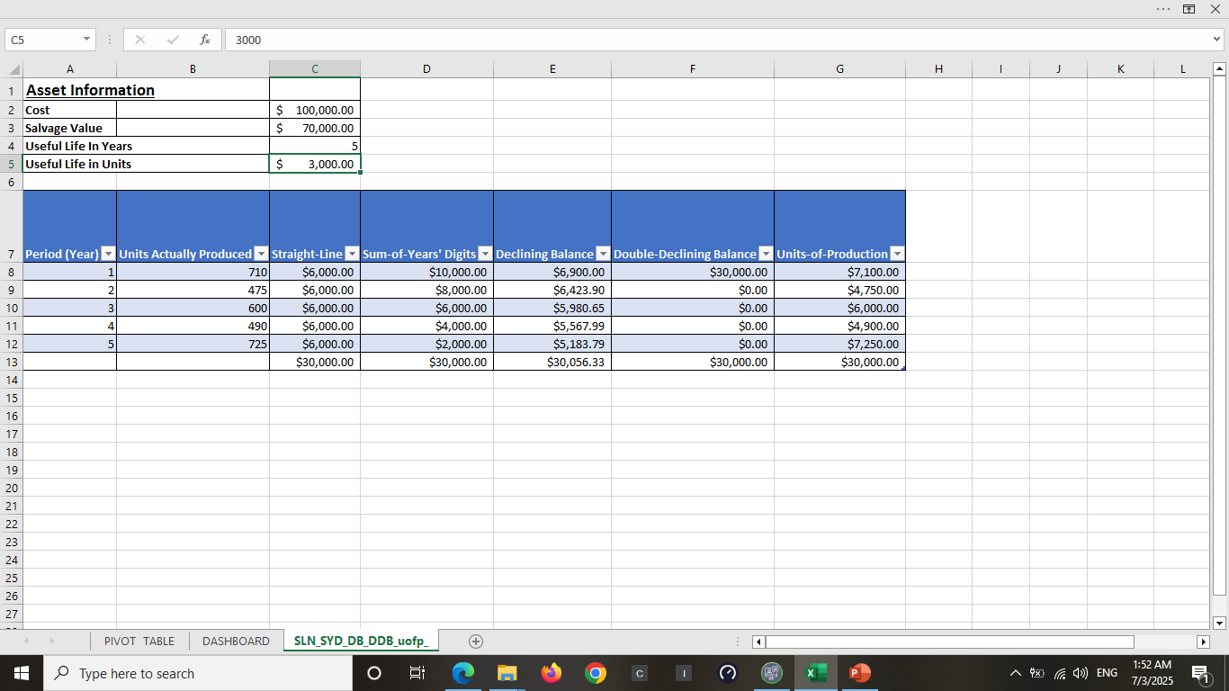
CALCULATE ASSEST VALUE IN STRAIGHT LINE ?? CALCULATE THE SLN,SYD,DB, DD, UNIT OF PRODUCTION??

Slide 14
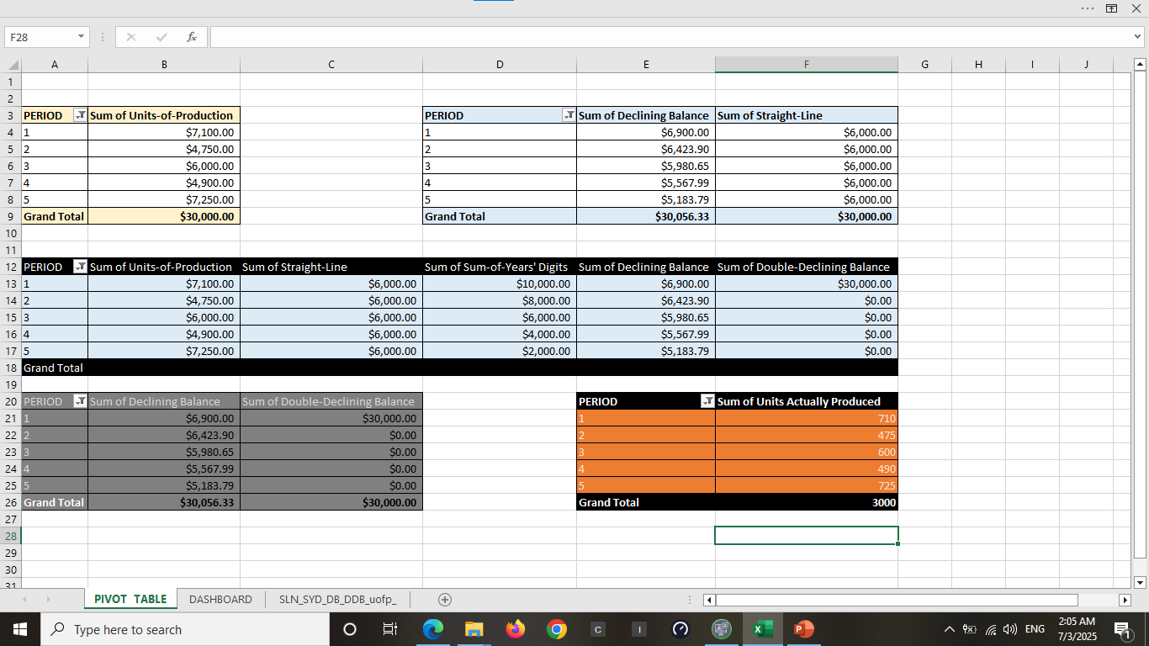

Slide 15
Let's do a quick analysis based on the data in your Excel pivot
Quick Analysis of Depreciation Methods
1. Asset Price (Cost)
Asset price across all methods = ₹30,000 (confirmed by Grand Totals under each method).
2. Straight-Line Method
Fixed annual depreciation: ₹6,000 every year for 5 years.
Total depreciation: ₹30,000
Depreciation Rate: 6,00030,000=20%\frac{6,000}{30,000} = 20\%30,0006,000​=20% per year.
Ideal for predictable and stable asset use.
. 3. Declining Balance Method
Year-wise depreciation:
Y1: ₹6,900
Y2: ₹6,423.90
Y3: ₹5,980.65
Y4: ₹5,567.99
Y5: ₹5,183.79
Total depreciation: ₹30,056.33 (slight rounding variance).
4. Units of Production Method
Based on actual units used each year (total: 3,000 units).

Slide 16
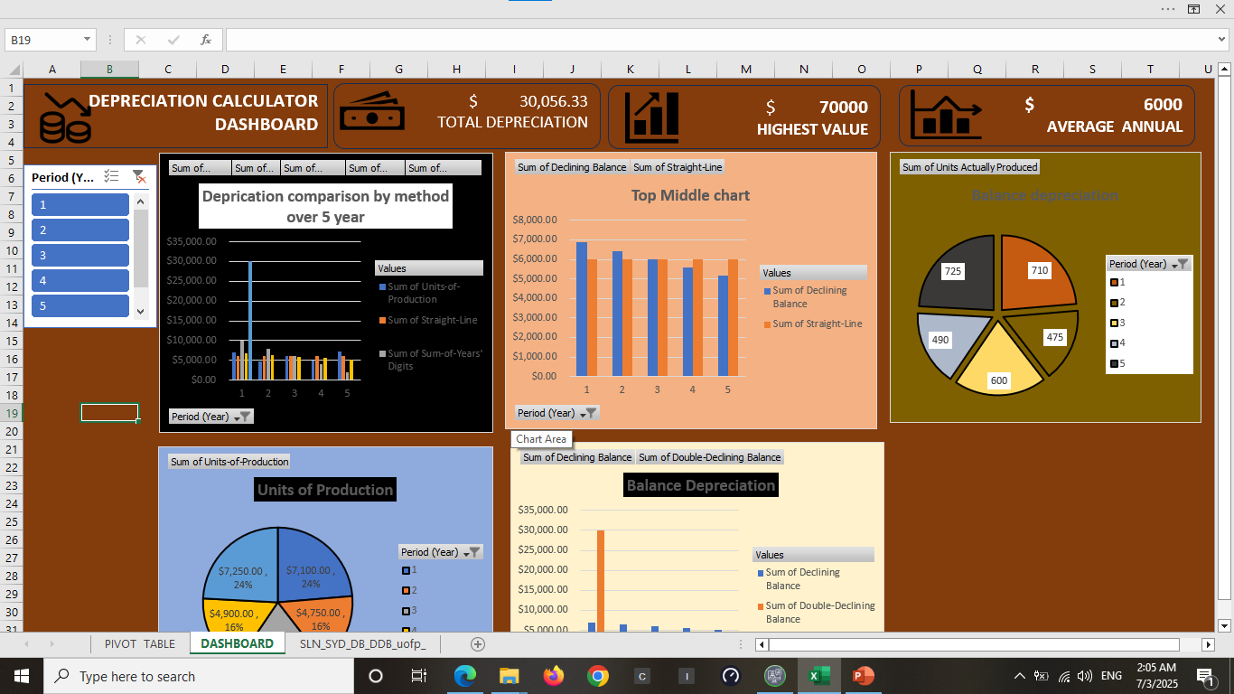
DEPRECIATION CALCULATOR DASHBOARD

Slide 17
🔍 Key Findings
Total Depreciation: $ 30,056.33 was the total depreciation applied over 5 years across various methods.
Highest Depreciation Value: $ 7,000 (from Units of Production method in Year 5)
Average Annual Depreciation: $ 6,000 under the Straight-Line Method — consistent and predictable yearly charge
Method Behavior:
Straight-Line: Constant depreciation ($ 6,000/year).
Declining Balance: Higher depreciation in earlier years; gradually decreases.
Double Declining Balance: Entire depreciation taken in Year 1.
Units of Production: Depreciation varies by asset usage (ranged from $4,750 to $7,250).

Slide 18
✅ Actionable Takeaways
Choose Depreciation Method Based on Asset Type:
Use Straight-Line for IT equipment, buildings, and assets with stable use.
Use Declining Balance for vehicles or tech that lose value quickly.
Use Units of Production for machinery tied directly to usage output.
Use Double Declining for tax benefits in early years (if allowed by law).
Optimize Asset Management:
Review usage-based depreciation to better estimate wear & tear.
Apply dynamic depreciation (not fixed) for high-usage or production-intensive equipment.
Plan Financial Forecasting:
Use your depreciation trends for cash flow planning and budget forecasting

Slide 19
Approaches & Insights
Excel Pivot Tables for clear data aggregation.
Multiple depreciation methods calculated and visualized.
Slicers for interactive filtering by year.
Visual dashboard with bar and pie charts for quick comparisons.
Insights
Straight-Line depreciation provides stability, but understates early loss of value.
Declining methods give a more realistic early valuation, useful for tech or high-use items.
Units of Production aligns cost with true usage, making it ideal for manufacturing firms.

Slide 20
🧾 Conclusion
This dashboard offers a comprehensive view of how depreciation affects asset value over time using different methods. It supports data-driven decisions for financial planning, asset replacement, and tax strategy.

